Slide 1
Job Submission Application System
By Kurt Muller, Seth Aker, & Joy He
Notes:
Good afternoon everyone,
Welcome to today's presentation on the Job Submission Application System.
My name is ______. I've been working with Kurt Muller and Seth Aker on this project
We are excited to showcase the features and functionalities that are incorporated into this system.

Slide 2
Table of contents
01 Project Overview
02 Stakeholder Analysis
03 Requirements Specifications
04 Data Model
05 Business Process Flows
06 Security Plan
07 Presentation
Notes:
Before we dive into the details of today's presentation, let me take a moment to guide you through the roadmap we'll be following. We will walk you through the project overview, stakeholder analysis, requirements specifications, data model, security plan, approval workflow, and, finally, we will demonstrate a live presentation of the application.

Slide 3
01
Project Overview

Slide 4
Purpose
•A company needs a new applicant tracking system for a talent acquisition company.
•The recruitment process needs to be streamlined.
•Need to create an end-to-end system to manage job listings, applications, and a proper approval process.
Notes:
Our talent acquisition company needs a streamlined recruitment process. We're aiming for increasing their efficiency by creating an end-to-end system to manage job listings, applications, and incorporate a proper approval process for new job applicants.

Slide 5
Scope
•Implement various Microsoft Power Platform into a single system.
•Develop a model-driven app to handle approvals and forms.
•Develop an external Power Pages App for applicants to apply to this company.
•Have the various Departments and Employees a given business process from start to finish with automation to bring the pieces together.
Notes:
We plan to implement the various components of the MS Power Platform into a single system. This will allow us for streamlined development of the system while also having the external and internal components of the system be well integrated. The power platform allows us to automate much of this work regarding approvals and notifications to ensure each stakeholder is active within this new system.

Slide 6
02
Stakeholder Analysis

Slide 7
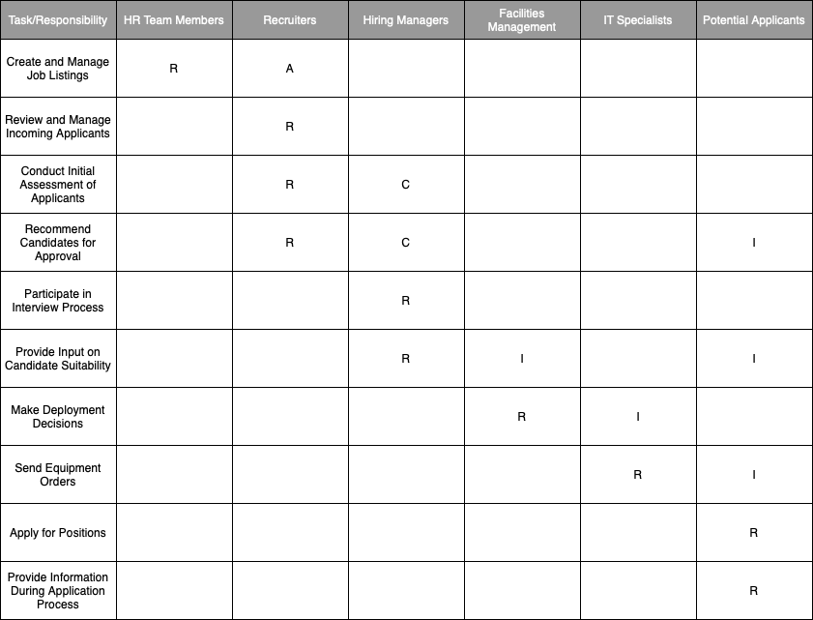
RACI Matrix
Notes:
To identify stakeholders and define their respective responsibilities in the project, we created a RACI matrix.
The HR Team is responsible for creating and managing job listings.
Recruiters are accountable for job listing creation and management. They are responsible for reviewing submitted applications and recommending candidates for further consideration.
Hiring managers are consulted in the process of recommending potential candidates, and they are responsible for participating in the interview process, providing input on candidate suitability, and notifying candidates of hiring decisions.
Facilities managers' responsibilities include assigning employees to deployment locations and updating the IT Specialists team with new hire information.
IT Specialists are informed of the deployment decisions and are responsible for processing equipment orders.
Potential applicants are responsible for applying for the positions listed in the system and providing information during the application process.

Slide 8
03
Requirement Specifications

Slide 9
Functional Requirements
Equipment Orders & Management
Applicant Registration
Employee Deployment
Job Listing Creation & Management
Interview Scheduling & Results
Application Submission & Lifecycle
Application Review/Approval Process
Notes:
Based on our stakeholder analysis, we were able to come up with our functional requirements for our system. Each stakeholder has specific needs that we have put into User Stories on Azure DevOps to track the various different requirements for each part of our system. The requirements we specified had different user stories from which we derived our specific requirements from. The full list of our requirements can be found on our Azure DevOps board.

Slide 10
04
Data Model

Slide 11
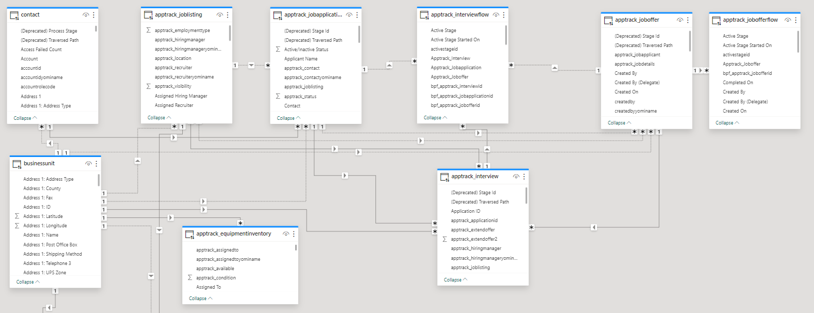
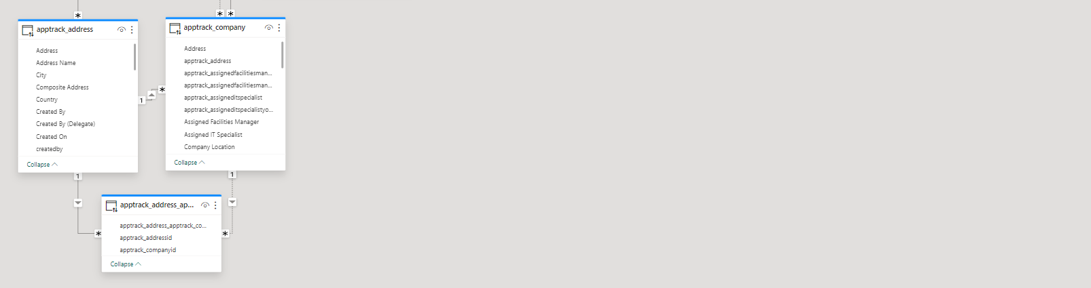
Notes:
Here is the design of our data model. Creating a consistent and accurate design of our database from the beginning will enable developers to easily implement & fulfill the requirements that our database needs to fulfill within our system. For one relationship, the applicant data is stored in the 'Contact,' in which we create a one to many relationship with the 'Job Application' tables. There are further relationships that enforce data integrity and simple access to data between our tables. By ensuring good database design & efficiency, we can mitigate complexities and potential issues that would arise in future development stages.

Slide 12
05
Business Process Flow

Slide 13
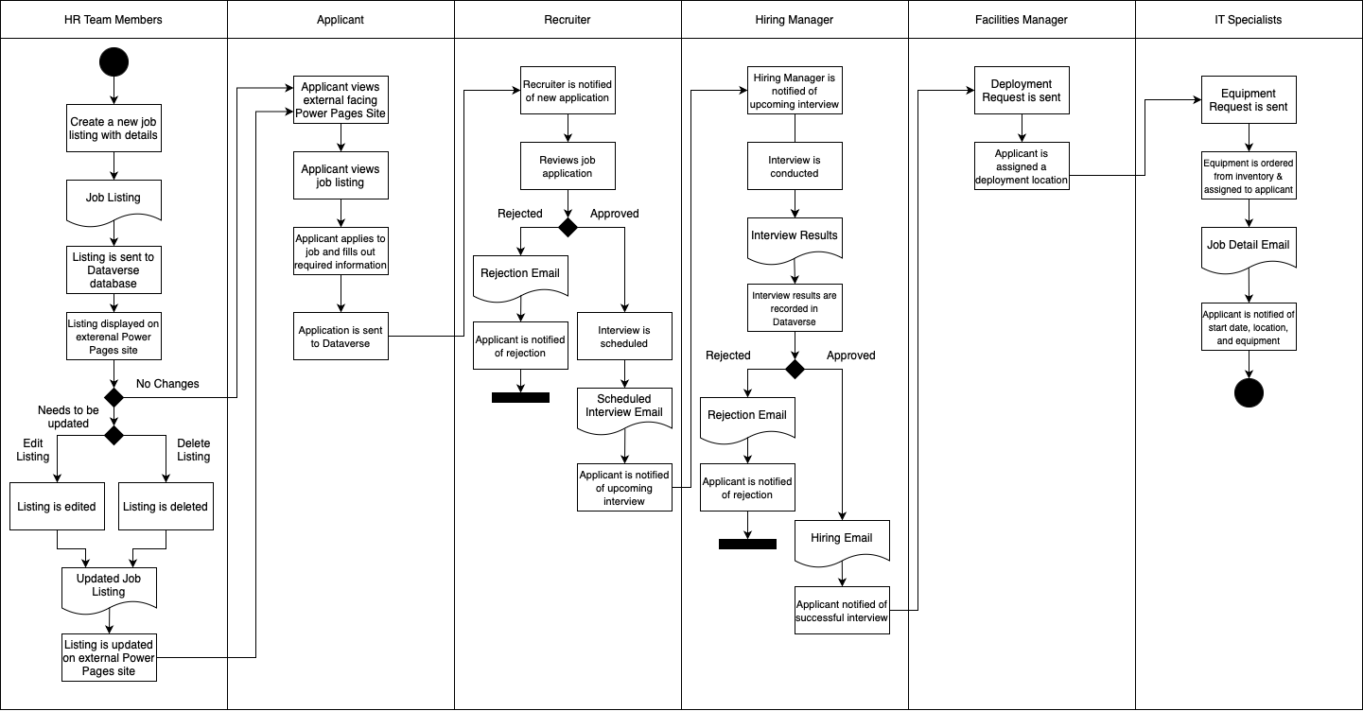
Business Process Flow Diagram
Notes:
The projects follow the Business Process Flow as shown in the diagram. HR Team creates jobs in the initial step, stored in the Dataverse, allowing updates or deletions. Applicants apply via an external Power Pages Site, sending their applications to the Dataverse. Recruiters receive notifications, make decisions on applications, moving candidates to interviews or rejecting them. Approved applications trigger hiring manager notifications for interview scheduling and decisions. Facilities managers assign deployment locations upon hiring, and IT Specialists request equipment based on locations, notifying new hires.

Slide 14
06
Security Plan

Slide 15
Security Roles
Human Resources
Human Resources
HR Team Member
Permissions: Create, Read, Update Job Listings
Tables: Job Listing, Job Application
Hiring Manager
Permissions: Conduct interviews, read interview results, approve or reject candidates post-interview.
Tables: Job Listing, Job Application
Recruiter
Permissions: Read job applications, approve or reject applications.
Tables: Contact (read-only), Job Application, Interview (read-only).
Facilities Manager
Permissions: Create, Read, Update Job Listings
Tables: Employee, Deployment Location
IT Specialist
Permissions: Create, Read, Update Job Listings
Tables: Employee, Deployment Location (read-only), Equipment Inventory
Information Technology
Notes:
To ensure that only the proper employees have access to only necessary data, security roles were created in our Model-Driven app. These roles are assignable to the various employees that are in our organization that have access to the environment. It streamlines our user experience by decluttering the interface, showing users only the data and options relevant to their roles. It also ensures that access to sensitive data is strictly controlled and monitored.

Slide 16
07
Presentation
Notes:
Now let us showcase the live presentation of the Job Submission Application System.

Slide 17
08
Conclusion
Notes:
In conclusion, the work of stakeholder analysis, requirements definition, and system design by the Business Analyst paved the way for the seamless integration of Microsoft's Power Platform components. This approach resulted in the creation of a robust and efficient Applicant Tracking System meets the expectations and needs of its stakeholders. This showcases the full design of a project for a given company, transforming its business needs into tangible solutions.

Slide 18
Thank You!

